Slide 1


A CLOUD-BASED NAVIGATIONAL SYSTEM USING FRAME DIFFERENTATION AND TRAFFIC DENSITY DETECTION

Slide 2




Commuting
Students
Profesionals
Common People

Slide 3
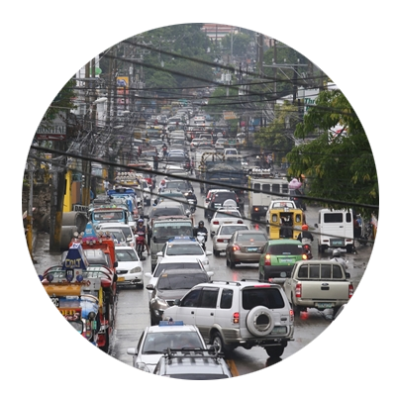


Slide 4




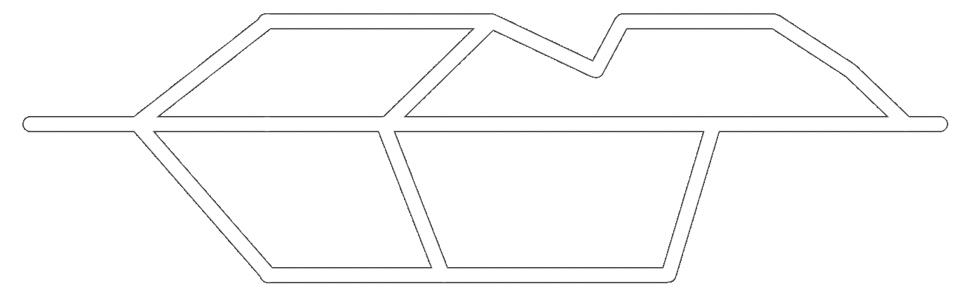



?
23 mins
15 mins
8 mins
#forever
10 mins
5 mins
10mins
10mins
3 mins
5 mins

Slide 5
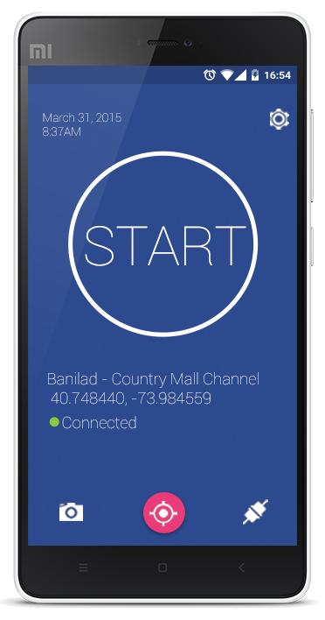



Develop a mobile based
Navigational system
Integrated traffic monitoring system
Uses cloud computing techniques
To apply image processing, decision-making
and graphing algorithms

Slide 6


Researchers
School
Commuters and Drivers
Government

Slide 7
A CLOUD-BASED NAVIGATIONAL SYSTEM USING FRAME DIFFERENTATION AND TRAFFIC DENSITY DETECTION

Slide 8
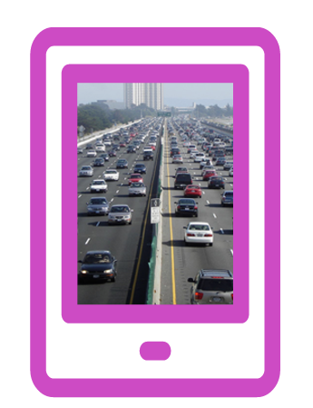


Channel App
Server App
User App
TRAFFIC
INFO
XXXX
XXXX
MONITOR
ANALYZE
DISSEMINATE

Slide 9











Slide 10
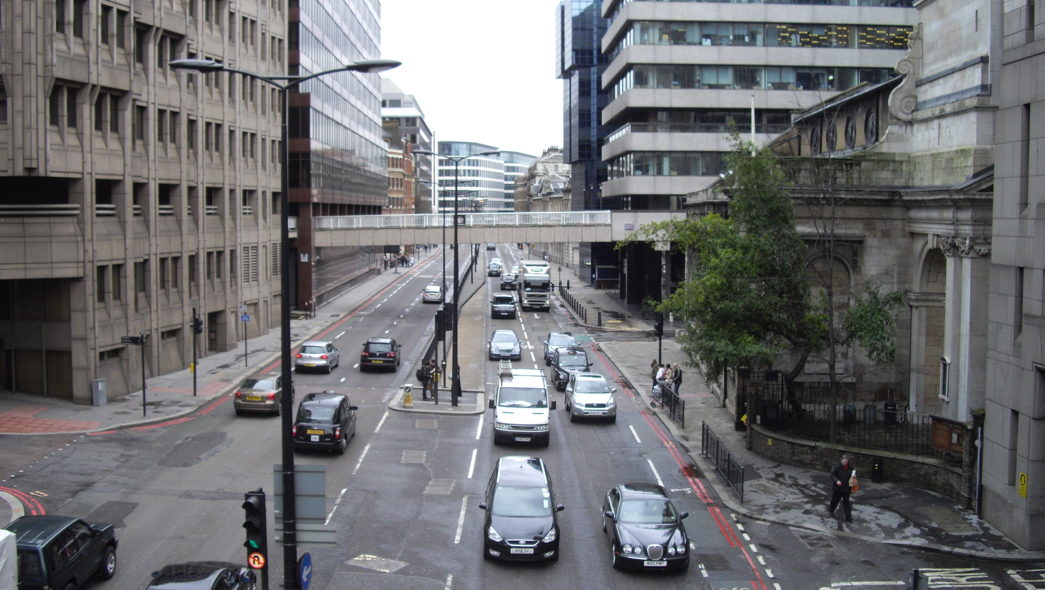


CHANNEL APP

Slide 11
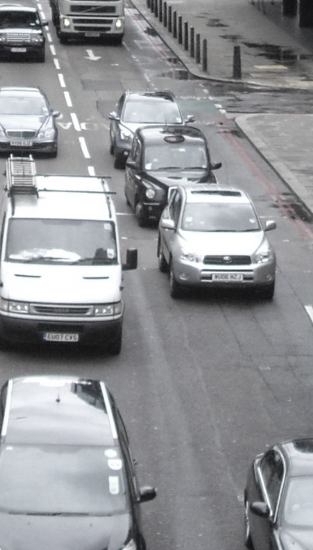
SERVER
Tagging
Image Processing

Receive Image

low
medium
high
Send Data


    
Djikstra’s Algorithm
Gather from other channels

Slide 12
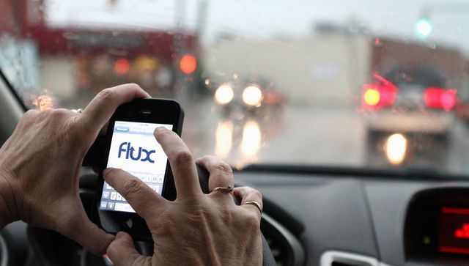
USER APP

Slide 13
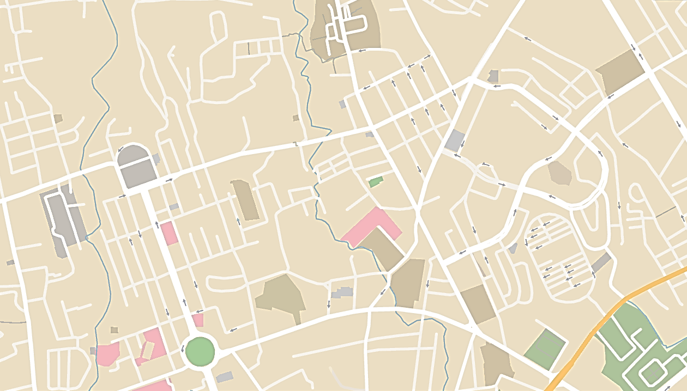
CHANNEL | LOCATION
A | Cebu Capitol facing Jones Avenue
B | Escario near Golden Peak Hotel facing Capitol
C | Mango Jollibee facing Fuente
D | Gorordo, facing CIC
E | Near Perpetual Soccour Hospital facing Golden Peak
F | Near Tune Hotel facing Golden Peak







Slide 14
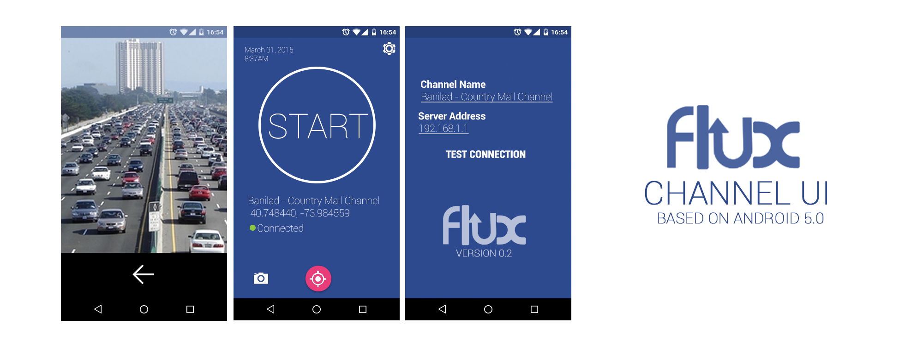

Slide 15
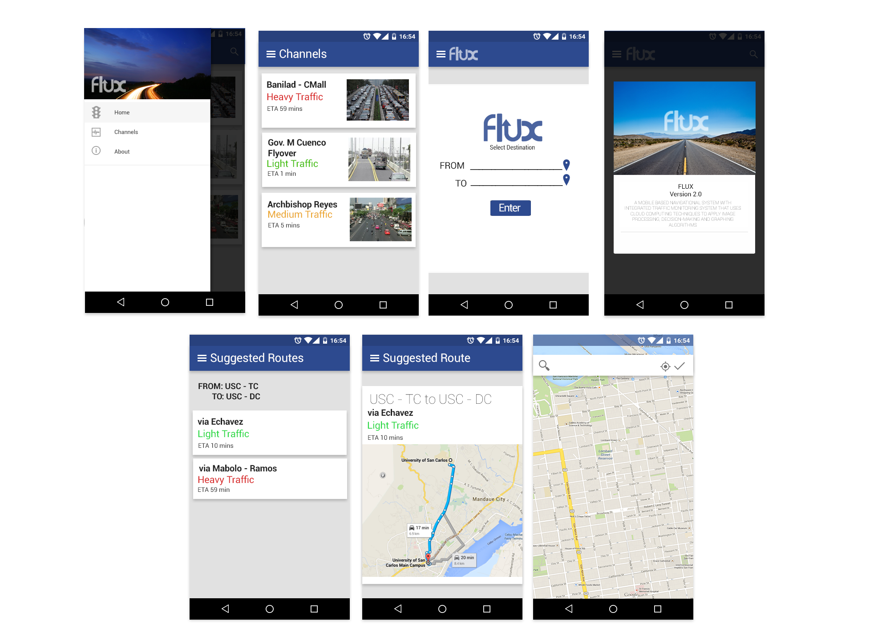

Slide 17
A CLOUD-BASED NAVIGATIONAL SYSTEM USING FRAME DIFFERENTATION AND TRAFFIC DENSITY DETECTION
THANK YOU!

